Slide 1
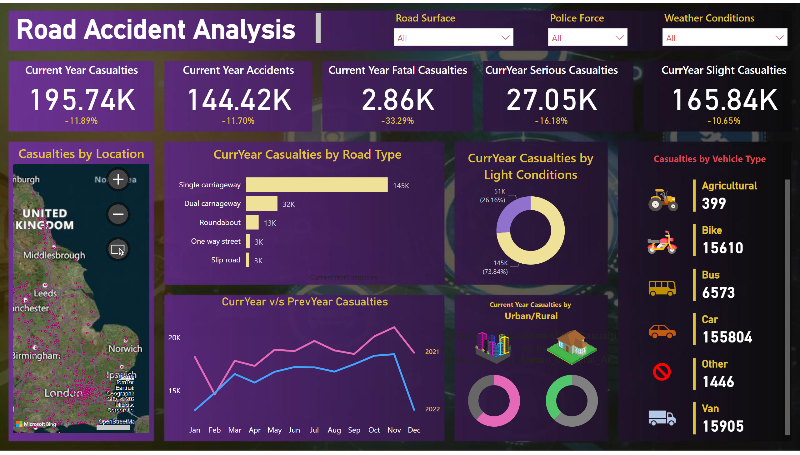
Page 1
Notes:
card
No alt text provided
Current Year Casualties
No alt text provided
card
No alt text provided
Current Year Accidents
No alt text provided
card
No alt text provided
Current Year Fatal Casualties
No alt text provided
card
No alt text provided
CurrYear Serious Casualties
No alt text provided
card
No alt text provided
CurrYear Slight Casualties
No alt text provided
textbox
No alt text provided
image
No alt text provided
multiRowCard
No alt text provided
image
No alt text provided
image
No alt text provided
image
No alt text provided
image
No alt text provided
image
No alt text provided
textbox
No alt text provided
CurrYear v/s PrevYear Casualties
No alt text provided
image
No alt text provided
image
No alt text provided
donutChart
No alt text provided
donutChart
No alt text provided
textbox
No alt text provided
CurrYear Casualties by Light Conditions
No alt text provided
CurrYear Casualties by Road Type
No alt text provided
Casualties by Location
No alt text provided
slicer
No alt text provided
slicer
No alt text provided
slicer
No alt text provided

